Slide 1


How will I stand myself globally
Recognized??

Slide 2
Toyota
Toyota launched its Global Vision to be a global high quality , trusted, automotive brand synonymous with innovation
Toyota is tapping into their universal sense of adventure. Its global “Feeling the Street” campaign allowed people to vote on their favorite street musicians from around the world and follow six winners on a New Zealand road trip
Toyota is also harnessing digital platforms and geo-targeting technologies to position its cars within the context of peoples’ lives
In the U.S, Toyota targeted Los Angeles drivers with videos launched in the “Live Story” feature on Snapchat
Partnered with Google to customize ads in 15,000 U.S. cities that inspire real-life, local adventures

Slide 3
Toyota
This year Toyota launched new “Stand Together” (Lets go places) campaign. Toyota gathers people around the world and tries to give a message; “We generate power when we gather together “ . Grasping hands and connecting from everywhere in the world
The ‘Toyota Hybrid Solutions’ regional Facebook page, promoting its 'Hybrid Synergy Drive' (HSD) technology is part of a wider above-the-line digital campaign
Creating an entertaining YouTube brand channel, they combined digital production and video content to make the online research process more interactive and productive

Slide 4
Samsung
Its global “Next is Now” campaign built anticipation around the launch of its Galaxy phones by previewing its innovative features
Samsung aired Ads during the 2015 Oscars .The ads align with a company-wide commitment to proving that digital innovation can enrich peoples’ lives
Its ongoing “Launching People” campaign, which shares the stories of people who use Samsung products to turn their visions

Slide 5
Samsung
Samsung Galaxy Note 7 , Busy Busy Busy campaign with Christoph Waltz:
Galaxy Note 7 is defined by Cristoph Waltz. The smartphone Galaxy Note 7 allows people to multitask. The ad message says, take a picture of what you do and share extra-curriculars in a fun way
Samsung Unpacking 1988 to 2016: Samsung’s release of the new Galaxy S7, Galaxy S7 edge and Gear 360 is being promoted with a commercial covering the unpacking of new models, from the release of the SH-100 mobile phone in 1988 to the first wristwatch phone, the world’s smallest TV phone to Samsung’s first MP3 phone.

Slide 6
GE
GE’s marketing efforts have focused on new storytelling platforms
35–40 percent of its marketing budget allocated to digital media
Apart from Facebook, Twitter, YouTube, Instagram the company is tapping into platforms like Wattpad, Vine, Tumblr, and Snapchat to spark conversations with audiences and solve real business problems, both by curating new ideas and pushing industry-leading
GE invites Instagram influencers to tour the GE facilities, encouraging them to share this rare look behind the scenes using the hashtag #GEInstaWalk
Just recently, it rolled out a series of commercials with the tagline “The Digital Company. That’s Also an Industrial Company”

Slide 7
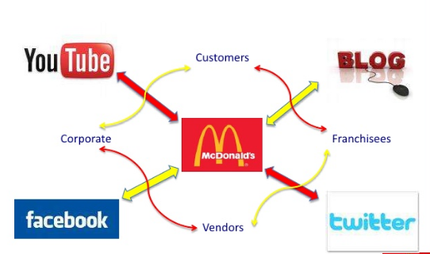
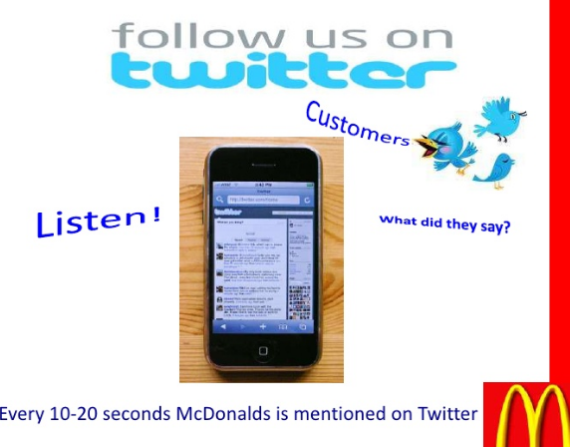
McDonald’s
McDonald's Launches 'Moments of Joy' in 24 Cities #imlovinit campaign . 24 gifts of joy. In 24 cities. Over 24 hours. "Moments of joy" marks McDonald's biggest global push since "I'm lovin' it,"
The company opened up a line of dialogue by expanding its “Our food. Your questions.” initiative, a social media campaign that aims to answer all customer questions transparently
McDonald’s Is the First Brand to Use Snapchat’s Latest Sponsored Geofilters.
Users can head to any US McDonald’s store and use this feature to add more color and life to their snaps. The feature is met with a lot of enthusiasm by fans on twitter

Slide 8












Oracle
They spent a lot time and money on R&D(Research & Development) by executing Larry Ellison’s vision “turn the 38-year-old technology leader into the number one cloud company in the world.”
Virtually its entire software is now offered as cloud services.
Cloud Built-in
Purpose Built
General Purpose
Big Data
Exadata
Exalogic
SPARC
SuperCluster

Slide 9

Nike
Nike launched its biggest-ever female focused advertising push with the “Better for It” campaign.
In addition to “Better for It,” there was the whimsical World Cup– themed “Winner Stays On,” a tribute to LeBron James following his NBA defeat, and an ode to the last-place marathon finisher.
They believe in “Change is in the air for Nike.”

Slide 10
HP
The USP of HP is that it has got largest division in its corporate history.
The company continues to innovate, and its most ambitious research effort is The Machine, which reinvents the fundamental architecture of computers to enable a quantum leap in performance, power efficiency, and security.
Efficient use of communication tools and tactics that HP used
Demand generation.
Sales and marketing tools.
Channel announcement email.
Channel Implementation guide.
Campaign Introduction video.

Slide 11
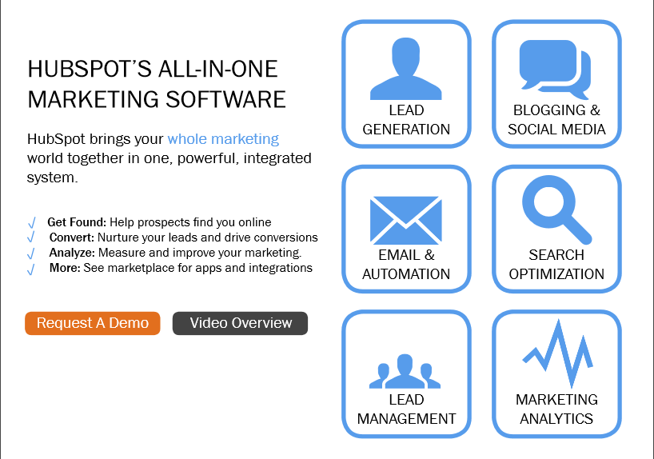
Small demo page on marketing software.

Slide 12
HONDA
Honda launched a campaign known as “The Endless Road,” which features a remarkably creative “never-ending” YouTube video that is bespoke to its audience—seamlessly personalized using real-time location data.
Honda is employing new products and novel marketing efforts to demonstrate innovation and progress.

Slide 13
Louis Vuitton
Grands Classiques (a French term for “coveted icons”) are new, innovative, and sometimes shocking when introduced, but over time they become classics.
A focus on retail and sales networks, along with a continued emphasis on creativity and quality.
“Don’t believe in borders,” and “dare to new frontiers” are just a few of the sentiments from “The Spirit of Travel,” Louis Vuitton’s campaign film, which values the experience of the journey as much as the destination.

